Slide 1
Distributed Data Pipelines Assignment 2
S10223485H – Tran Huy Minh
Presentation Link: https://youtu.be/Qm_b88Ye0g8

Slide 2

1. Problem Statement Formulation
Objective: develop real-time bus arrival timings data pipeline with data from Land Transport Authority (LTA)
Connected to: Power BI for frontend display of bus arrival information
Target audience: General public using public transportation
Bus arrival info enhances productivity and make a less stressful commuting experience for users

Slide 3
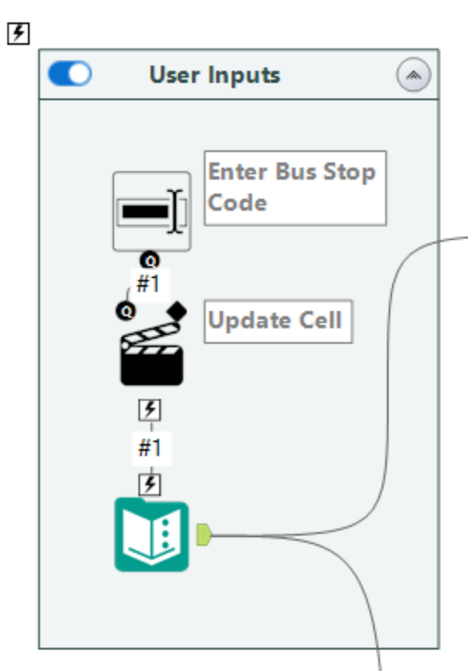
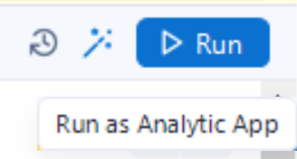
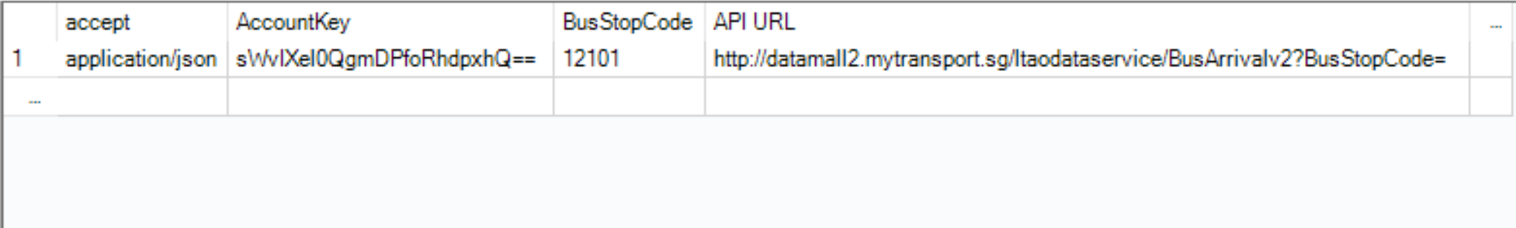
2. Preparation – prepare for API call based
Text Box
Action
Text Input

Slide 4
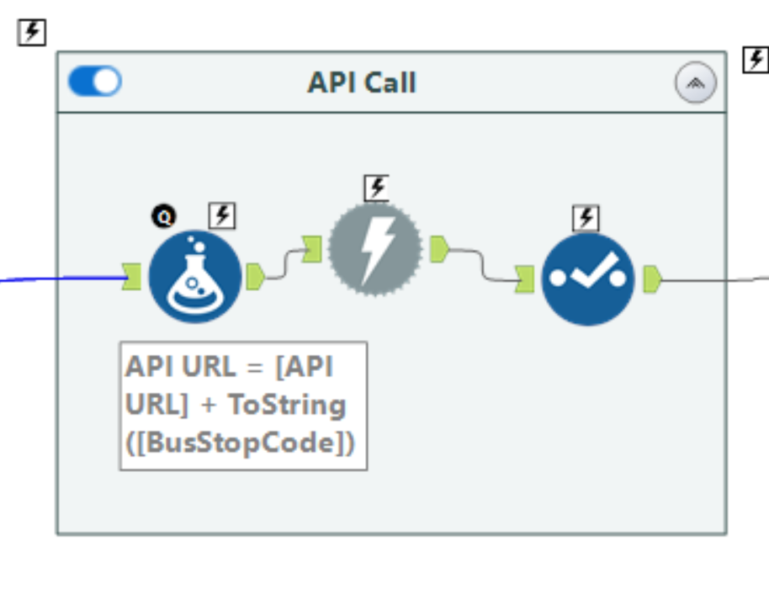
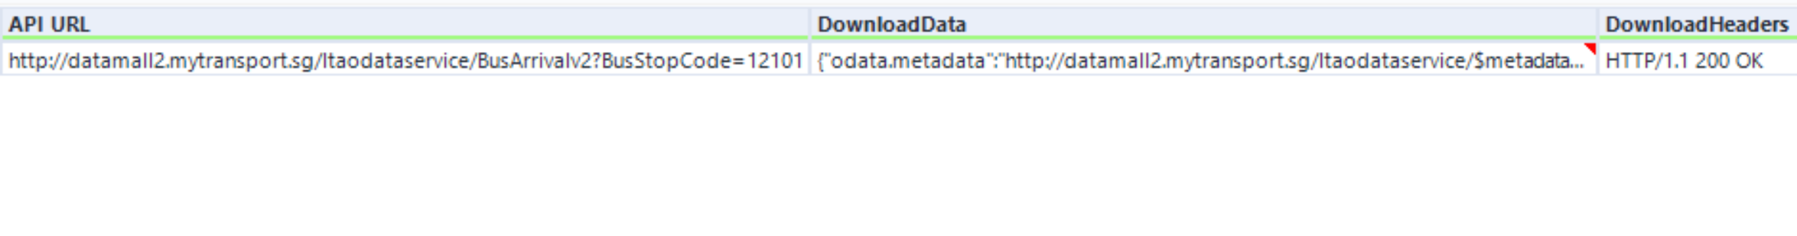
2. Preparation – prepare for API call based
API Response in JSON format
Download
Formula
Select
Concantenation of API URL
Unnecessary API response

Slide 5
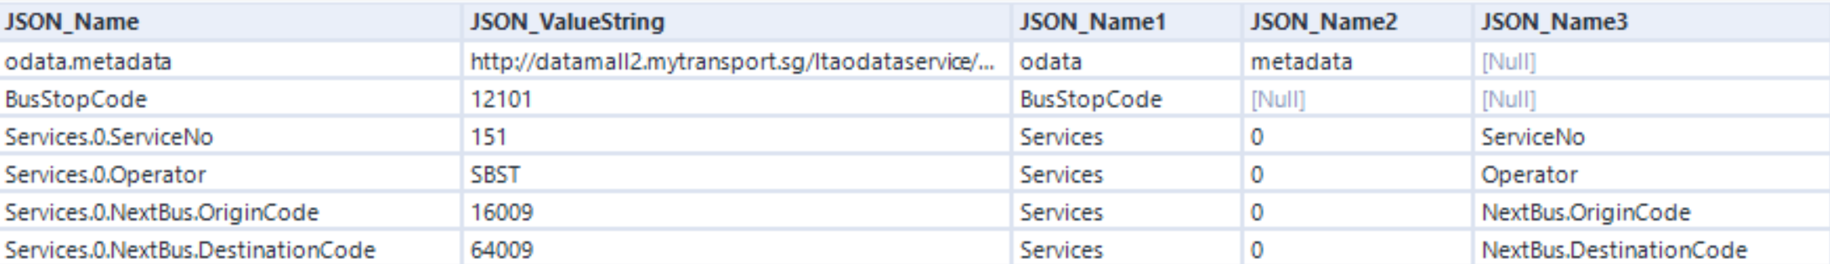
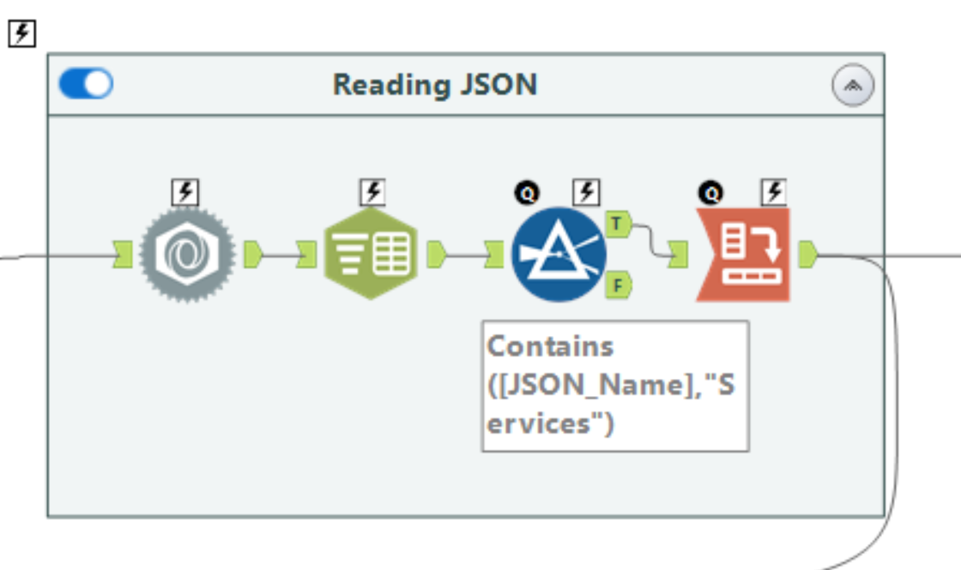
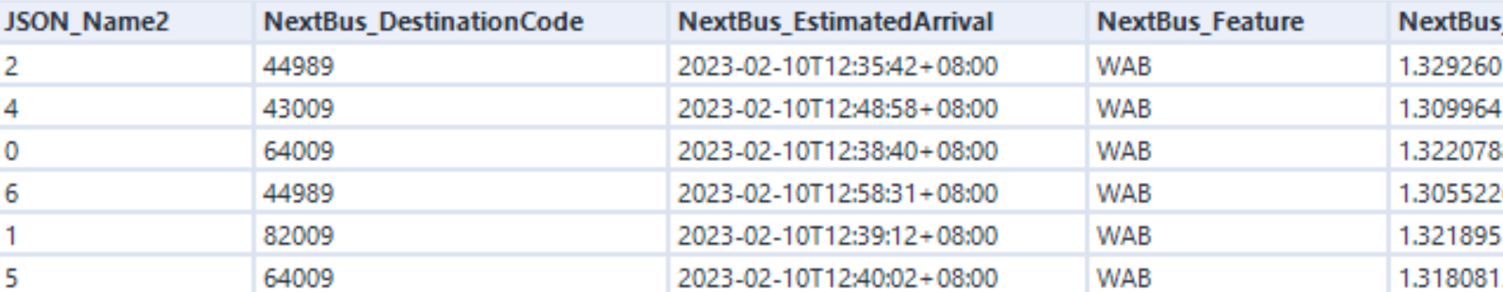
3. API Call – Transform data into appropriate format/structure
Data extracted from JSON Parse
Columns split using ‘.’ delimiter
JSON Parse
Filter
CrossTab
Unique Bus Service Number Identifier
Text to Columns
Group by Bus Service Number with CrossTab

Slide 6
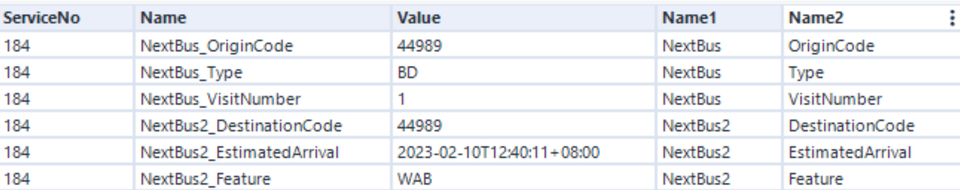
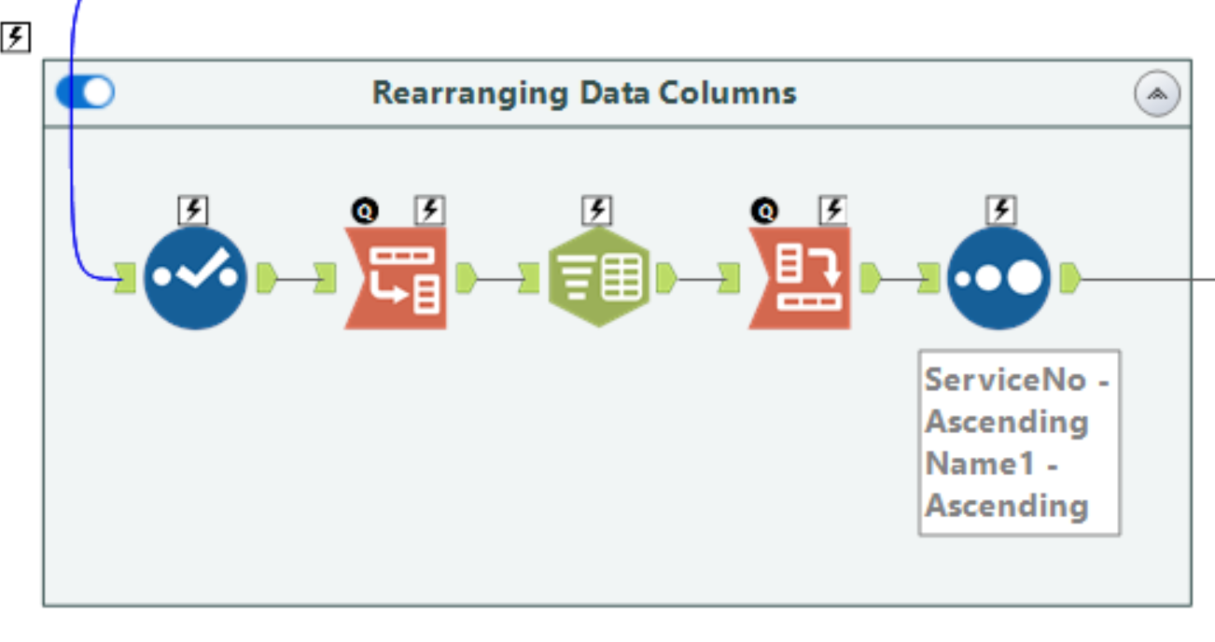
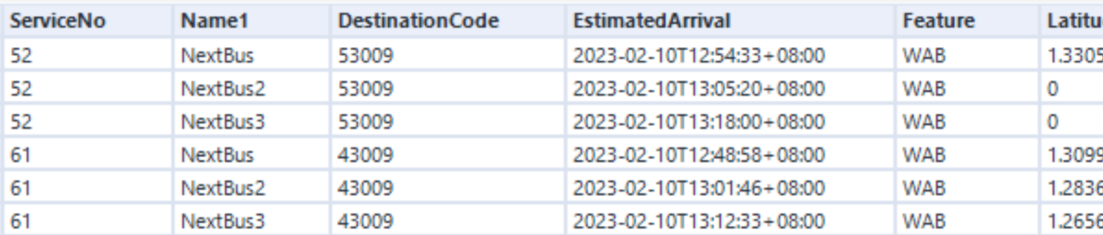
3. API Call – Transform data into appropriate format/structure
Columns split using ‘_’ delimiter
Select
Text to Columns
Sort
Bus information shared by all buses
Transpose
CrossTab
Remove Operator column
Group by ServiceNo + BusOrder, compound primary key

Slide 7
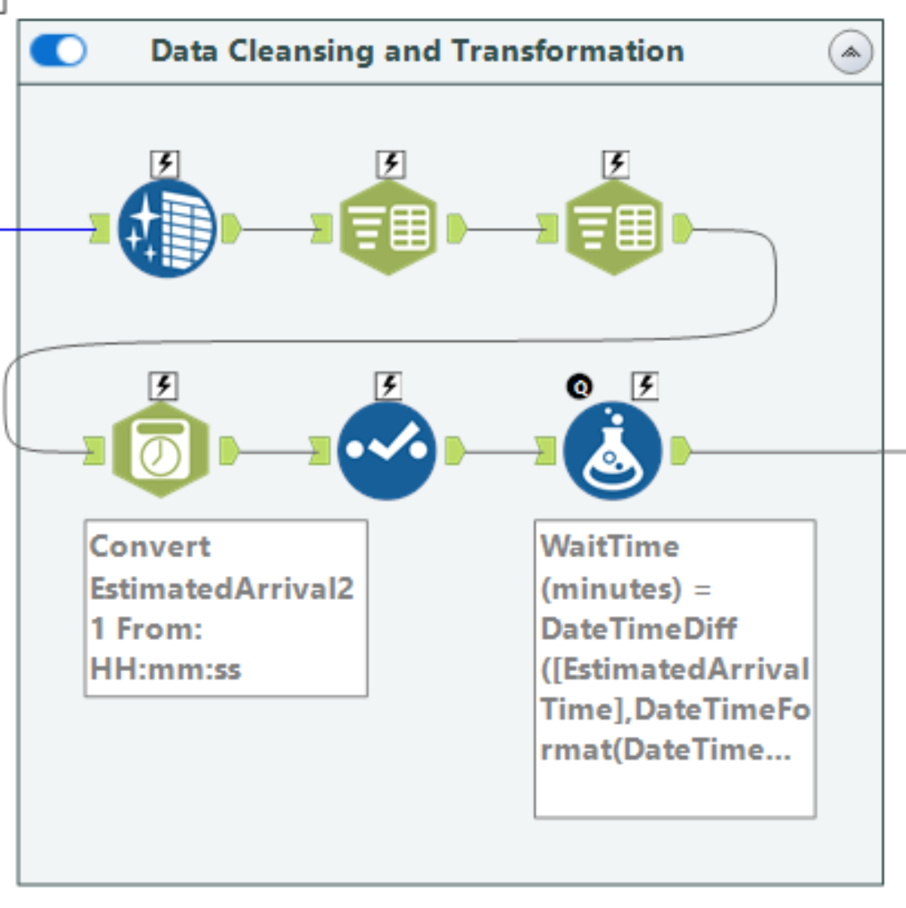
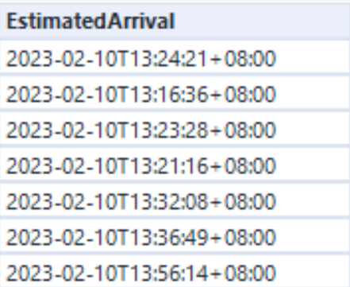
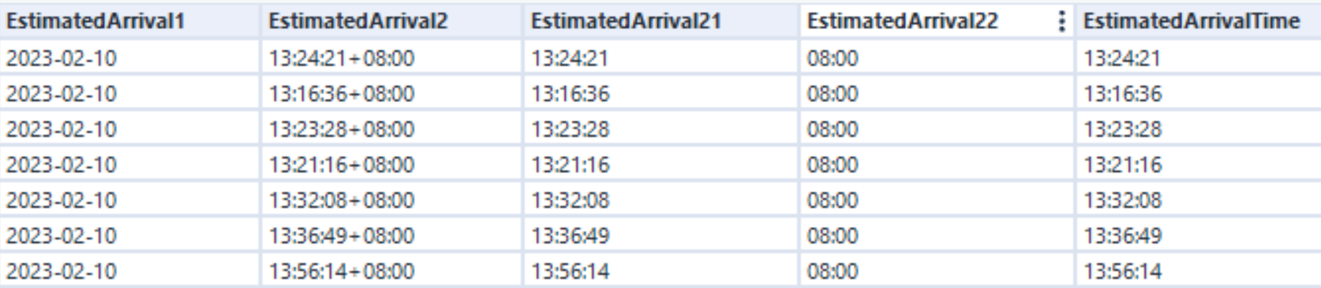
4. Data Display – Filter, Cleanse and Transform data for Display
Data Cleansing
Text to Columns
DateTime
Select
Formula
Conversion to DateTime format
Columns split using ‘T’ delimiter
Columns split using ‘+’ delimiter
Select Estimated Arrival Date and Time

Slide 8
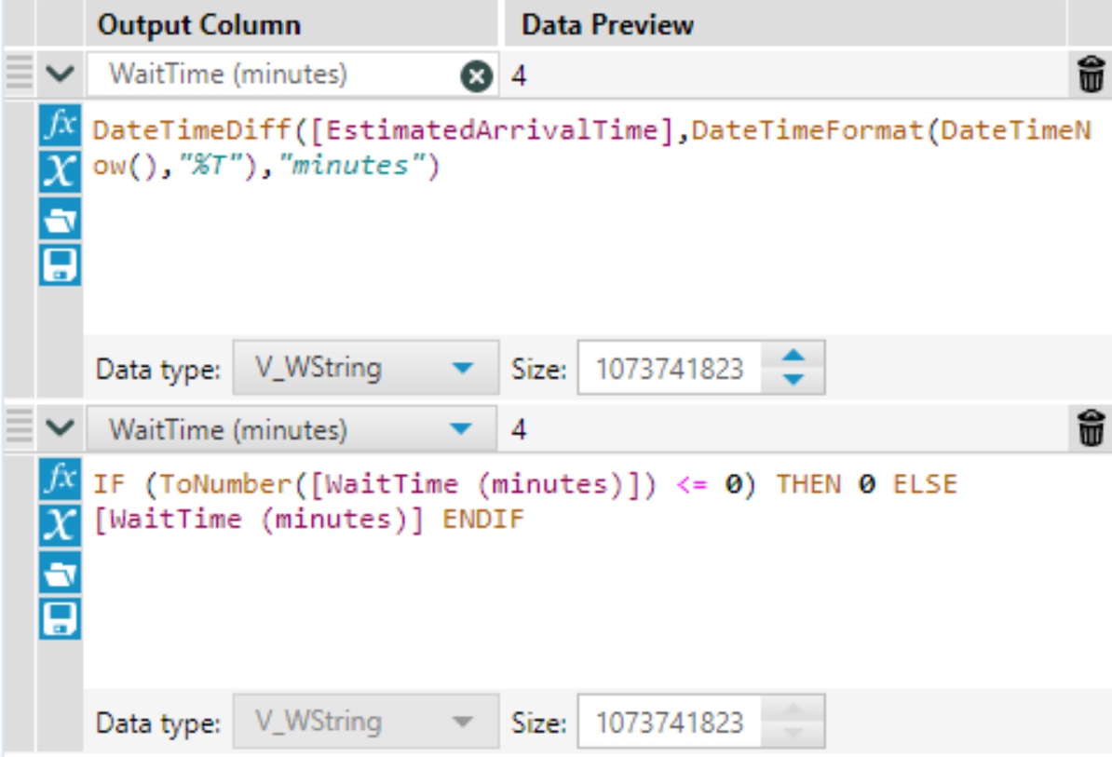
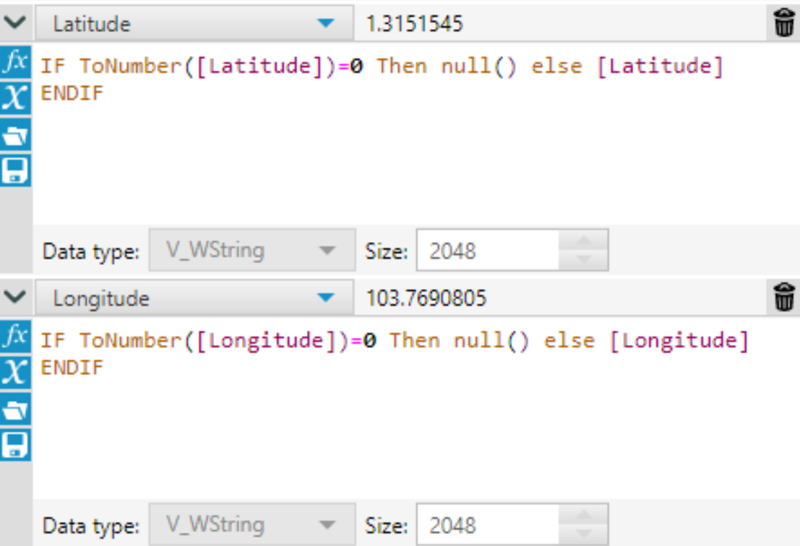
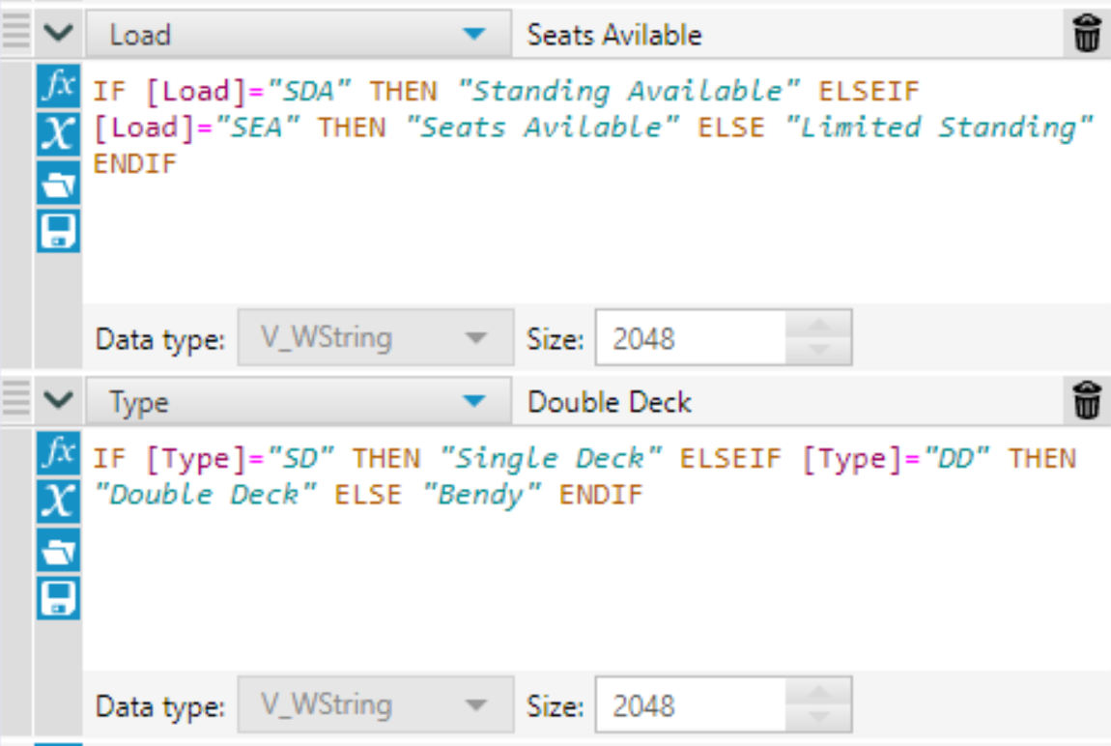
4. Data Display – Filter, Cleanse and Transform data for Display
WaitTime (minutes)
Latitude and Longitude
Load and Type
Useful new feature
Potential Visualization Error
User comprehension

Slide 9
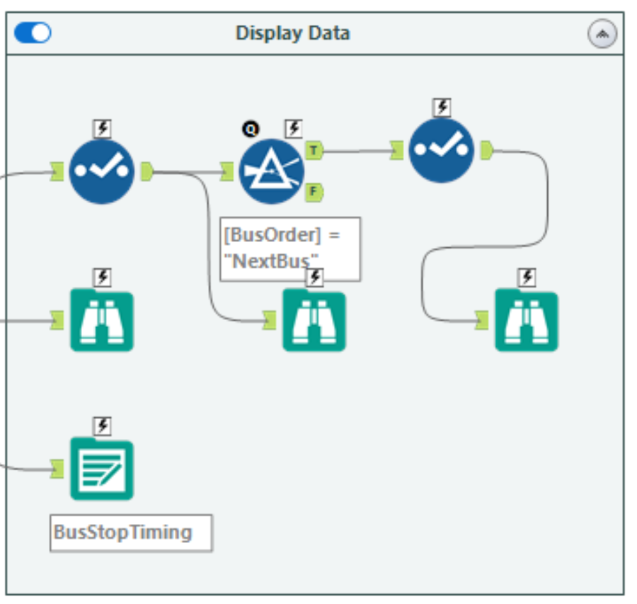
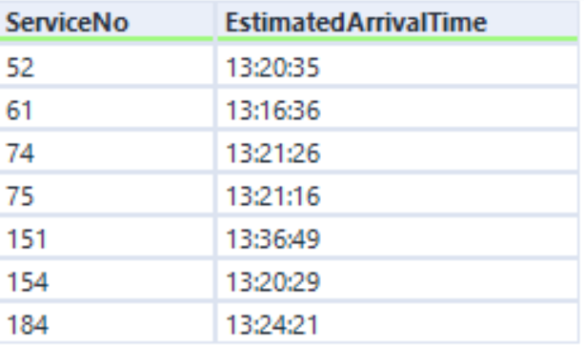
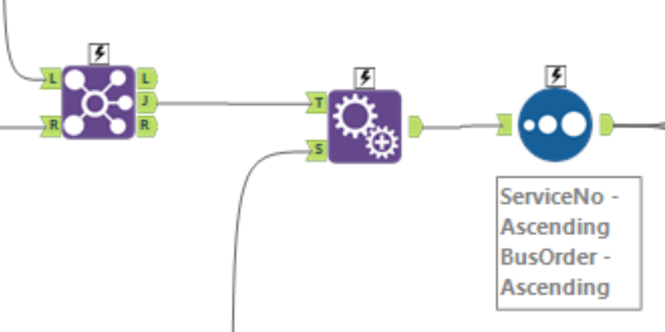
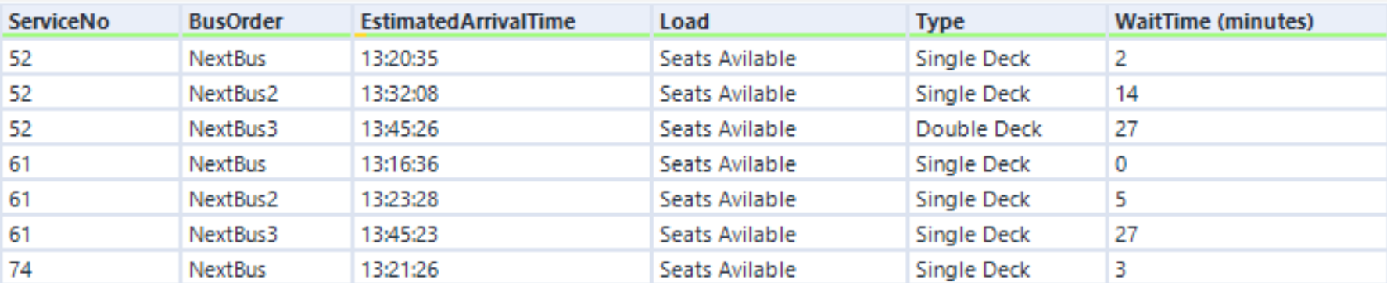
4. Data Display – Filter, Cleanse and Transform data for Display
Adds Operator column
Sort
Append Fields
Join
Adds BusStopCode column
Output Data – exports as BusStopTiming.txt

Slide 10
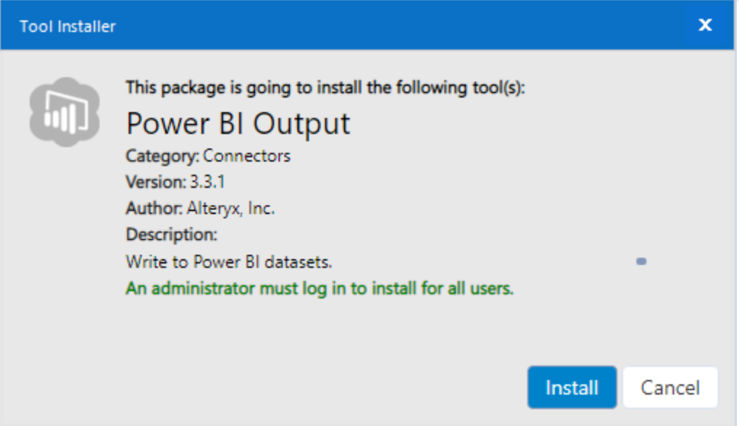
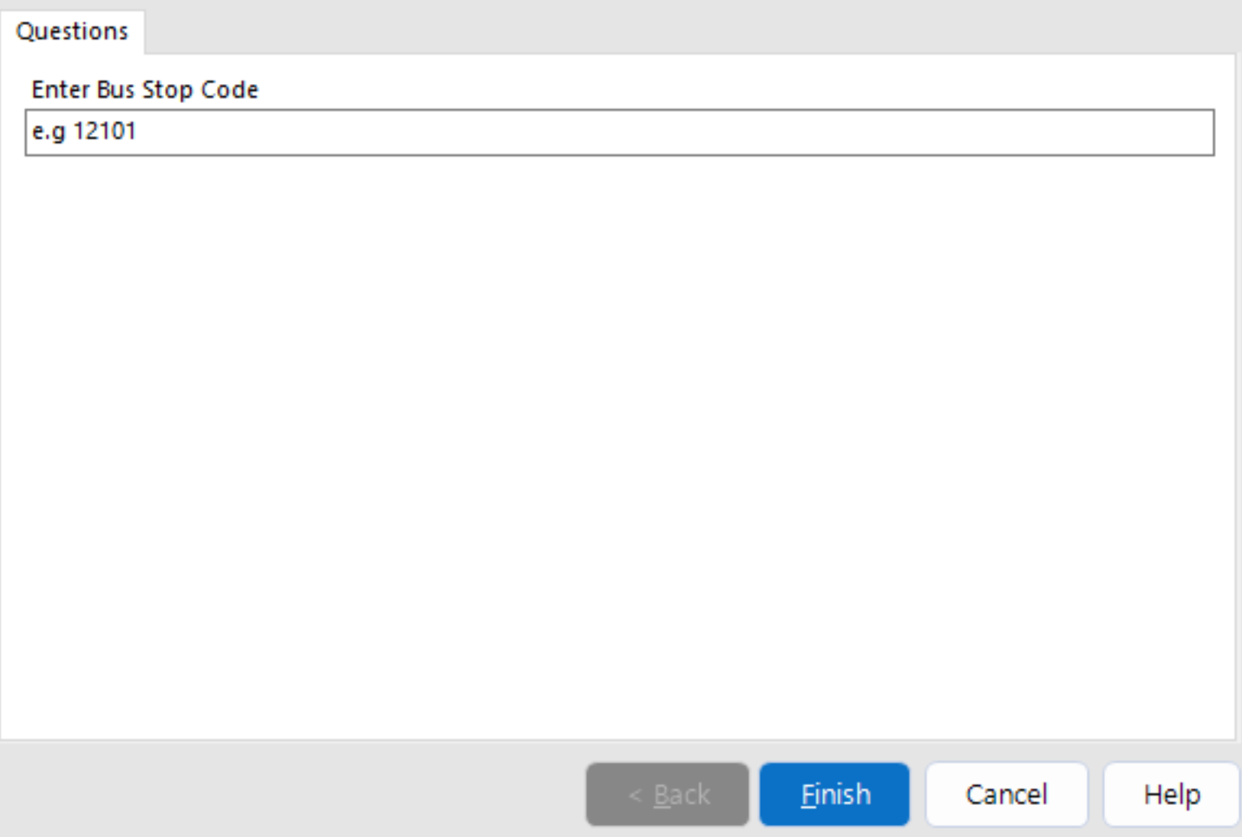
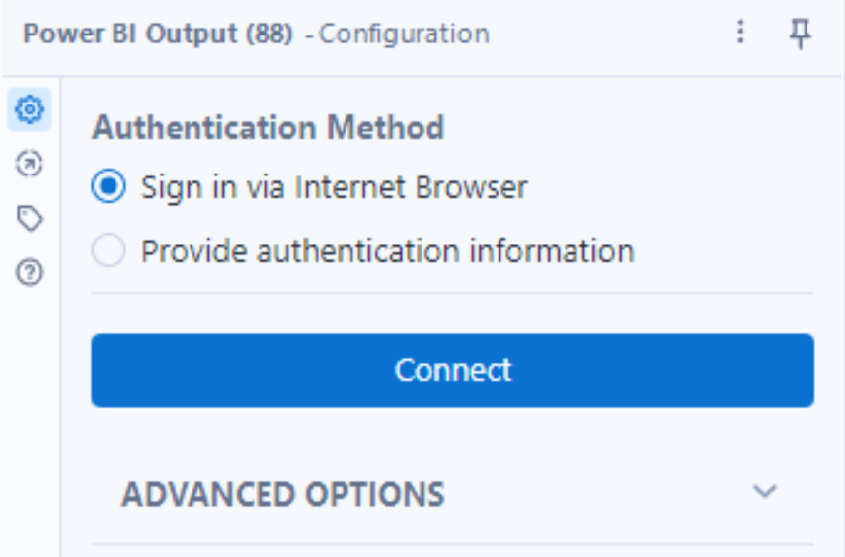
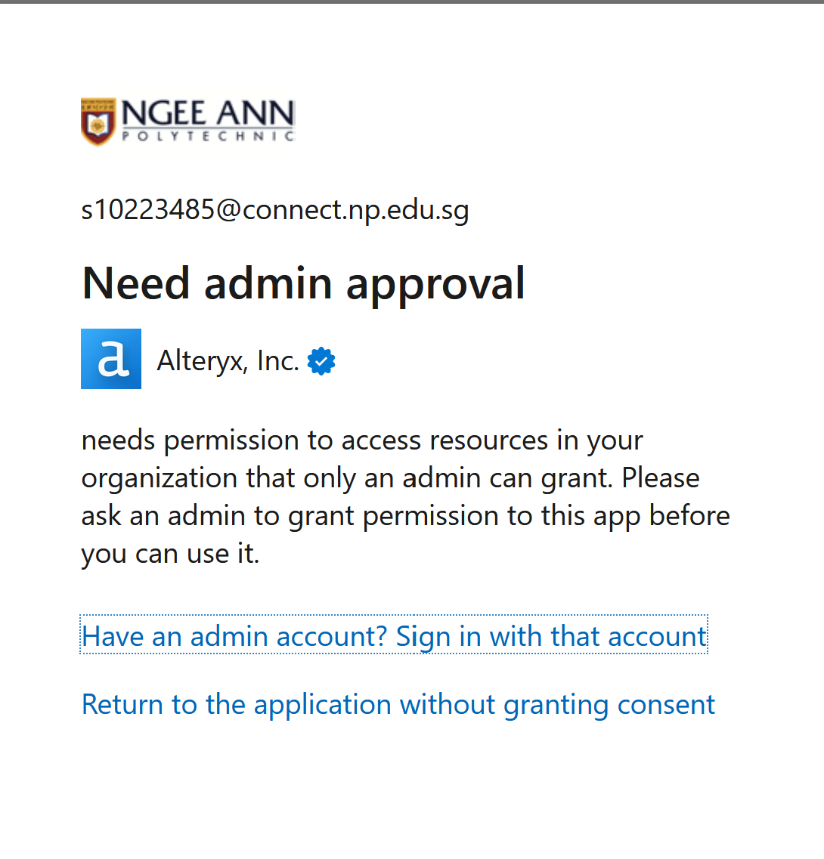
5. Enhancement
Customer User input for dynamic bus stop codes
Attempt at direct workflow to Power BI Connection

Slide 11
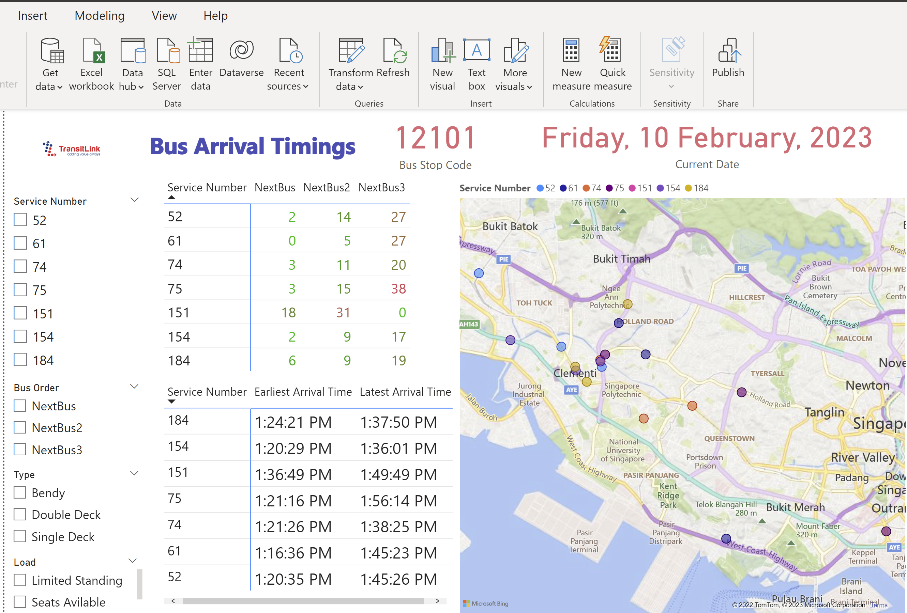
5. Enhancement
Updates values of dataset
Import BusStopTiming.txt

Slide 12
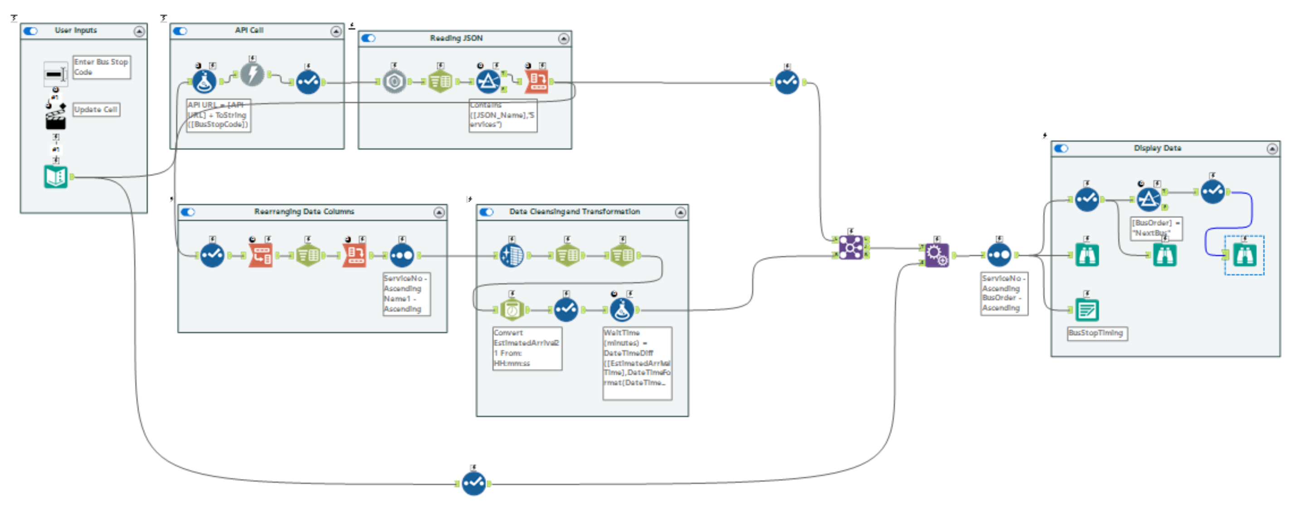
6. Summary

Slide 13


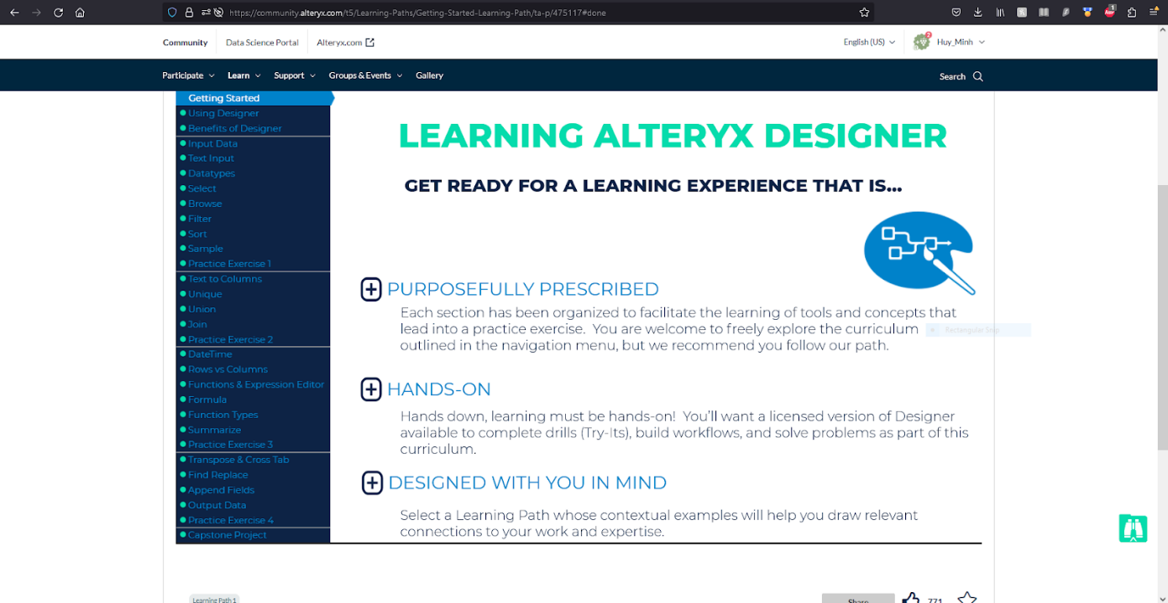
6. Summary

Slide 14
7. Reflection
Further improvements
Expanding dataset by making multiple API calls
Direct connection between Alteryx Designer and Power BI
Automating workflow with task scheduler
Improving user input UI in Power BI
Skills learnt and skills could have learnt better
Hands-on experience in designing and deploying data pipeline infrastructure
Knowledge of Apache Spark, Hadoop, and Alteryx
Could have learnt how to build real-time connections between backend data pipeline workflows and frontend displays better

